Slide 1
SSZG 518: Database Design and Applications
Today’s Class
File Organization
Indexing

Slide 2
Database Tables on Hard Disk
Database tables are made up of one or more tuples (rows)
Each tuple has one or more attributes
One or more tuples from a table are written into a block/page on the hard disk
Larger tuples may need more than one block/page!
Tuples on the disk are known as records
Records are separated by record delimiter
Attributes on the hard disk are known as fields
Fields are separated by field delimiter

Slide 3
File Organization
The physical arrangement of data in a file into records and blocks/pages on the disk
File organization determines the set of access methods for
Storing and retrieving records from a file
Therefore, ‘file organization’ synonymous with ‘access method’
We study three types of file organization
Unordered or Heap files
Ordered or sequential files
Hash files
We examine each of them in terms of the operations we perform on the database
Insert a new record
Search for a record (or update a record)
Delete a record

Slide 4
Unordered Or Heap File
Records are stored in the same order in which they are created
Insert operation
Fast – because the incoming record is written at the end of the last page of the file
Search (or update) operation
Slow – because linear search is performed on pages
Delete Operation
Slow – because the record to be deleted is first searched for
Deleting the record creates a hole in the page
Periodic file compacting work required to reclaim the wasted space

Slide 5
Ordered or Sequential File
Records are sorted on the values of one or more fields
Ordering field – the field on which the records are sorted
Ordering key – the key of the file when it is used for record sorting
Search (or update) Operation
Fast – because binary search is performed on sorted records
Update the ordering field?
Delete Operation
Fast – because searching the record is fast
Periodic file compacting work is, of course, required
Insert Operation
Poor – because if we insert the new record in the correct position we need to shift all the subsequent records in the file
Alternatively an ‘overflow file’ is created which contains all the new records as a heap
Periodically overflow file is merged with the main file
If overflow file is created search and delete operations for records in the overflow file have to be linear!

Slide 6
Hash File
Is an array of buckets
Given a record, r a hash function, h(r) computes the index of the bucket in which record r belongs
h uses one or more fields in the record called hash fields
Hash key - the key of the file when it is used by the hash function
Example hash function
Assume that the staff last name is used as the hash field
Assume also that the hash file size is 26 buckets - each bucket corresponding to each of the letters from the alphabet
Then a hash function can be defined which computes the bucket address (index) based on the first letter in the last name.

Slide 7
Hash File (2)
Insert Operation
Fast – because the hash function computes the index of the bucket to which the record belongs
If that bucket is full you go to the next free one
Search Operation
Fast – because the hash function computes the index of the bucket
Performance may degrade if the record is not found in the bucket suggested by hash function
Delete Operation
Fast – once again for the same reason of hashing function being able to locate the record quick

Slide 8
Blocking
Blocking:
Refers to storing a number of records in one block on the disk.
Blocking factor (bfr) refers to the number of records per block.
There may be empty space in a block if an integral number of records do not fit in one block.
Spanned Records:
Refers to records that exceed the size of one or more blocks and hence span a number of blocks.

Slide 9
Files of Records
A file is a sequence of records, where each record is a collection of data values (or data items).
A file descriptor (or file header) includes information that describes the file, such as the field names and their data types, and the addresses of the file blocks on disk.
Records are stored on disk blocks.
The blocking factor bfr for a file is the (average) number of file records stored in a disk block.
A file can have fixed-length records or variable-length records.

Slide 10
Files of Records (contd.)
File records can be unspanned or spanned
Unspanned: no record can span two blocks
Spanned: a record can be stored in more than one block
The physical disk blocks that are allocated to hold the records of a file can be contiguous, linked, or indexed.
In a file of fixed-length records, all records have the same format. Usually, unspanned blocking is used with such files.
Files of variable-length records require additional information to be stored in each record, such as separator characters and field types.
Usually spanned blocking is used with such files.

Slide 11
Operation on Files
Typical file operations include:
OPEN: Readies the file for access, and associates a pointer that will refer to a current file record at each point in time.
FIND: Searches for the first file record that satisfies a certain condition, and makes it the current file record.
FINDNEXT: Searches for the next file record (from the current record) that satisfies a certain condition, and makes it the current file record.
READ: Reads the current file record into a program variable.
INSERT: Inserts a new record into the file & makes it the current file record.
DELETE: Removes the current file record from the file, usually by marking the record to indicate that it is no longer valid.
MODIFY: Changes the values of some fields of the current file record.
CLOSE: Terminates access to the file.
REORGANIZE: Reorganizes the file records.
For example, the records marked deleted are physically removed from the file or a new organization of the file records is created.
READ_ORDERED: Read the file blocks in order of a specific field of the file.

Slide 12
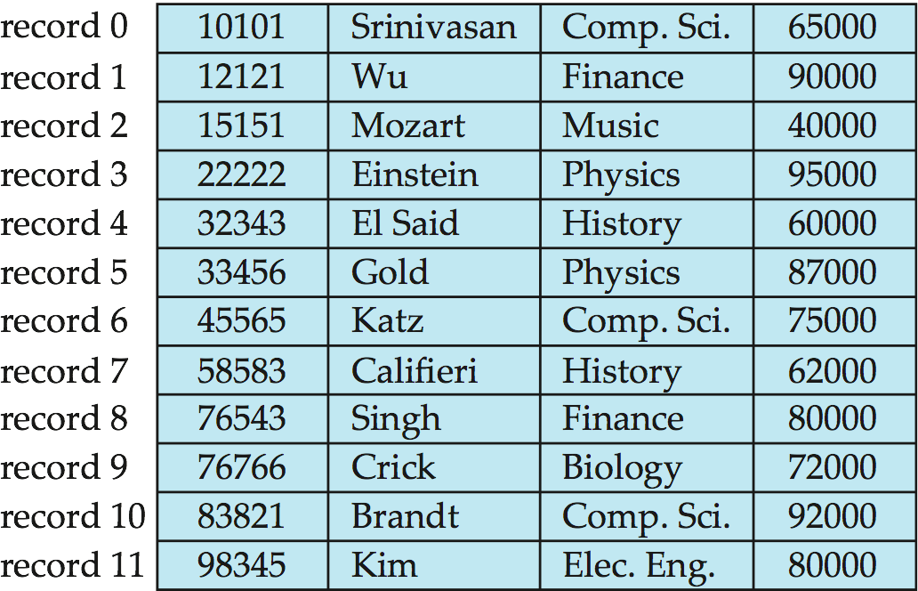
Fixed-Length Records
Simple approach:
Store record i starting from byte n ∗ (i – 1), where n is the size of each record.
Record access is simple but records may cross blocks
Modification: do not allow records to cross block boundaries
Deletion of record i: alternatives:
move records i + 1, . . ., n to i, . . . , n – 1
move record n to i
do not move records, but link all free records on a free list

Slide 13
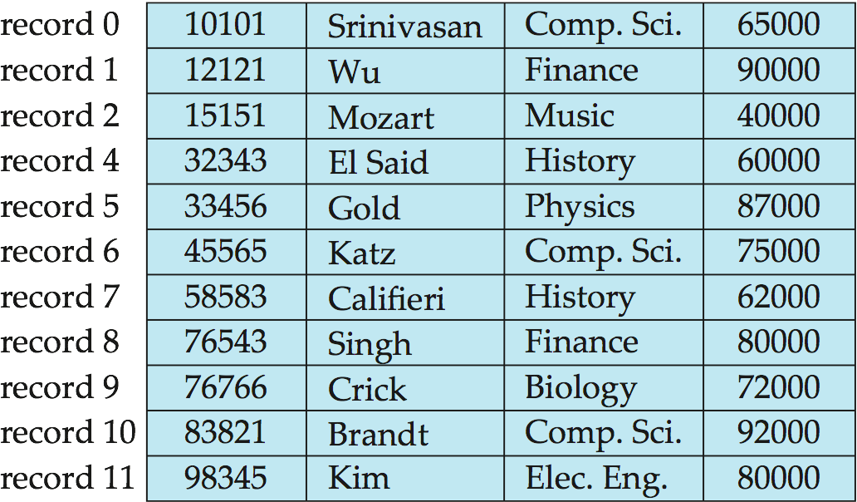
Deleting record 3 and compacting

Slide 14
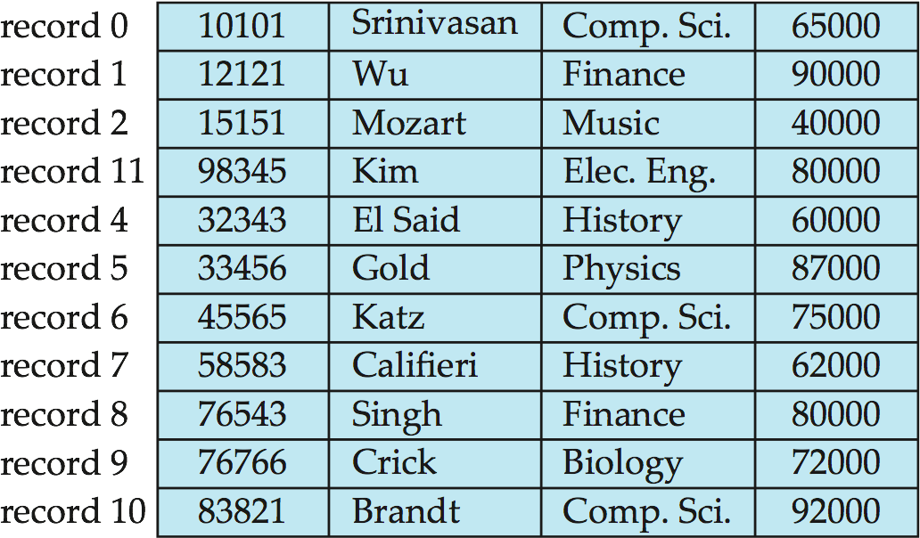
Deleting record 3 and moving last record

Slide 15
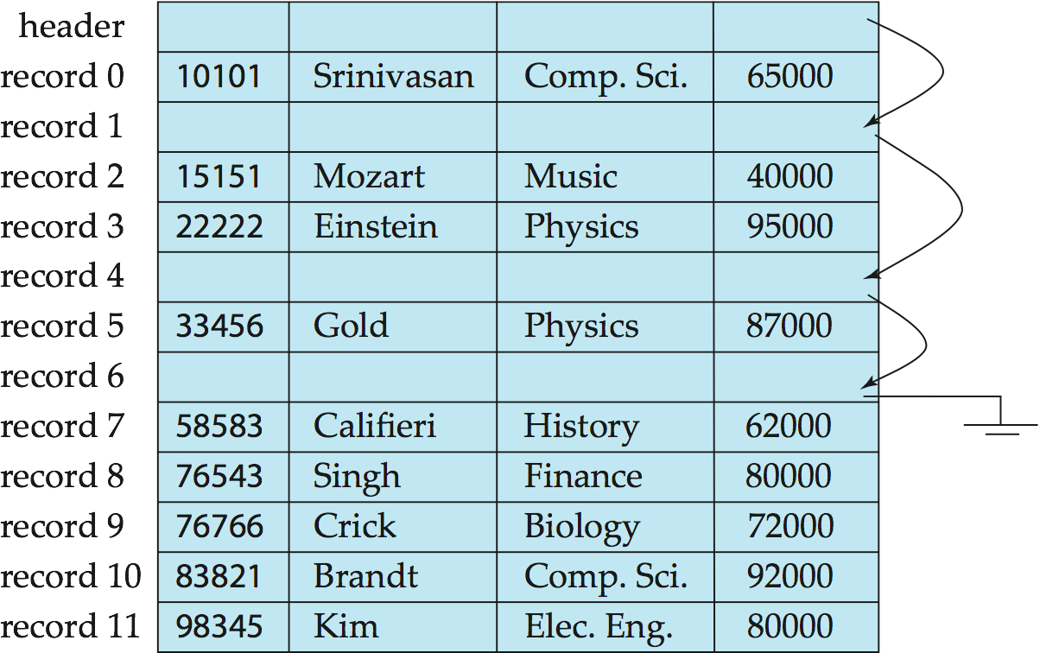
Free Lists
Store the address of the first deleted record in the file header.
Use this first record to store the address of the second deleted record, and so on
Can think of these stored addresses as pointers since they “point” to the location of a record.
More space efficient representation: reuse space for normal attributes of free records to store pointers. (No pointers stored in in-use records.)

Slide 16
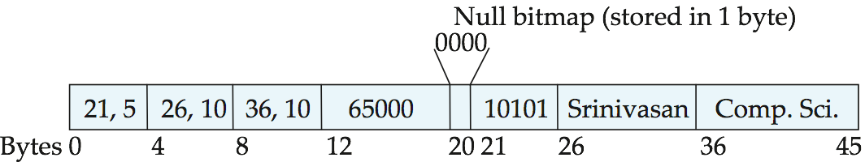
Variable-Length Records
Variable-length records arise in database systems in several ways:
Storage of multiple record types in a file.
Record types that allow variable lengths for one or more fields such as strings (varchar)
Record types that allow repeating fields (used in some older data models).
Attributes are stored in order
Variable length attributes represented by fixed size (offset, length), with actual data stored after all fixed length attributes
Null values represented by null-value bitmap

Slide 17
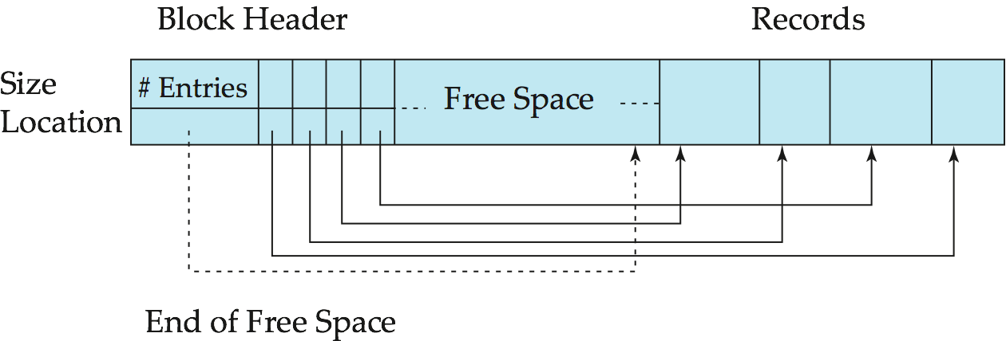
Variable-Length Records: Slotted Page Structure
Slotted page header contains:
number of record entries
end of free space in the block
location and size of each record
Records can be moved around within a page to keep them contiguous with no empty space between them; entry in the header must be updated.
Pointers should not point directly to record — instead they should point to the entry for the record in header.

Slide 18
Data on External Storage
Disks: Can retrieve random page at fixed cost
But reading several consecutive pages is much cheaper than reading them in random order
Tapes: Can only read pages in sequence
Cheaper than disks; used for archival storage
File organization: Method of arranging a file of records on external storage.
Record id (rid) is sufficient to physically locate record
Indexes are data structures that allow us to find the record ids of records with given values in index search key fields
Architecture: Buffer manager stages pages from external storage to main memory buffer pool. File and index layers make calls to the buffer manager.

Slide 19
Alternative File Organizations
Many alternatives exist, each ideal for some situations, and not so good in others:
Heap (random order) files: Suitable when typical access is a file scan retrieving all records.
Sorted Files: Best if records must be retrieved in some order, or only a `range’ of records is needed.
Indexes: Data structures to organize records via trees or hashing.
Like sorted files, they speed up searches for a subset of records, based on values in certain (“search key”) fields
Updates are much faster than in sorted files.
Notes:
2

Slide 20
Internal Schema Design

Slide 21
Unordered Files
Also called a heap or a pile file.
New records are inserted at the end of the file.
A linear search through the file records is necessary to search for a record.
This requires reading and searching half the file blocks on the average, and is hence quite expensive.
Record insertion is quite efficient.
Reading the records in order of a particular field requires sorting the file records.

Slide 22
Ordered Files
Also called a sequential file.
File records are kept sorted by the values of an ordering field.
Insertion is expensive: records must be inserted in the correct order.
It is common to keep a separate unordered overflow (or transaction) file for new records to improve insertion efficiency; this is periodically merged with the main ordered file.
A binary search can be used to search for a record on its ordering field value.
This requires reading and searching log₂ of the file blocks on the average, an improvement over linear search.
Reading the records in order of the ordering field is quite efficient.

Slide 23
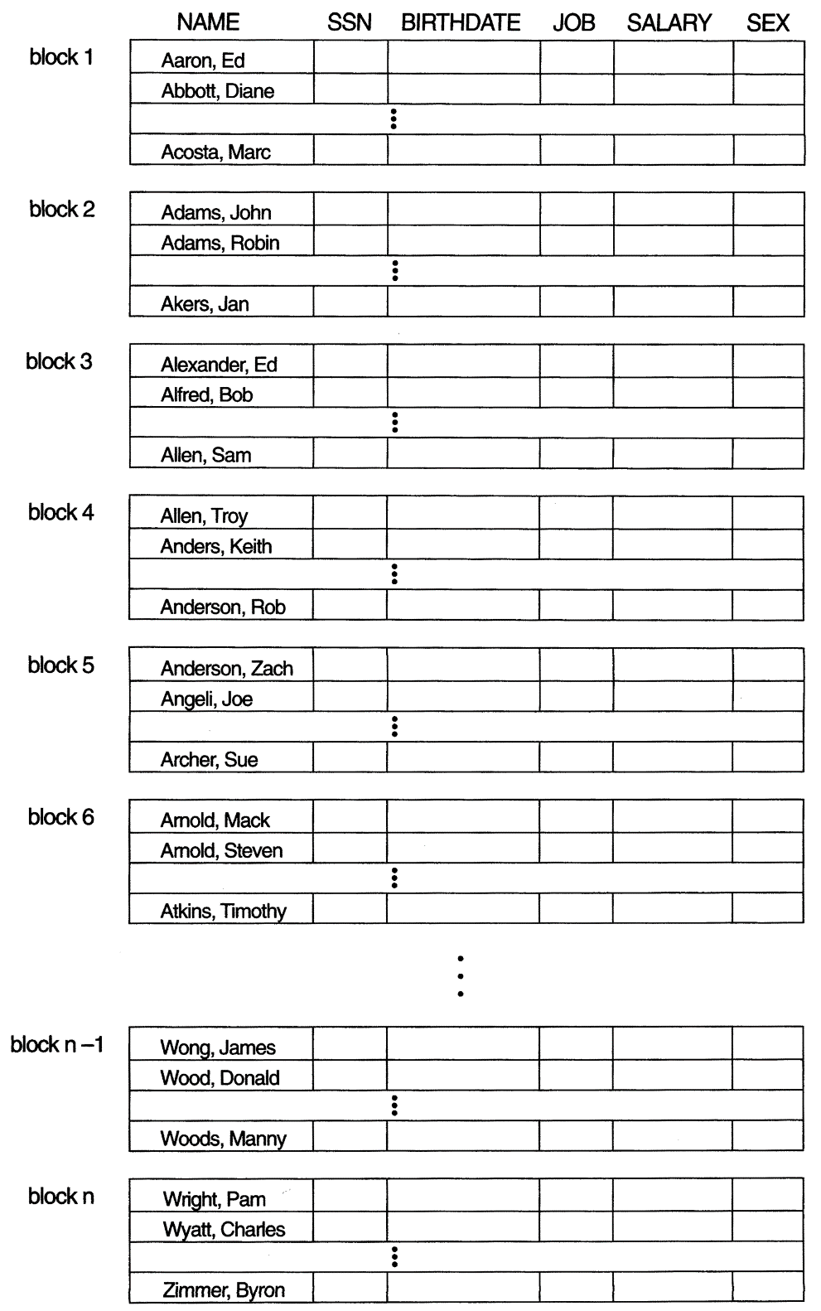
Ordered Files

Slide 24
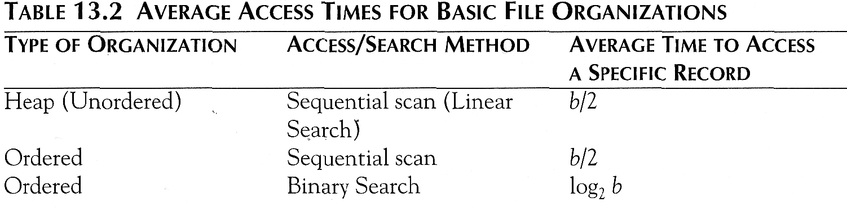
Average Access Times
The following table shows the average access time to access a specific record for a given type of file

Slide 25
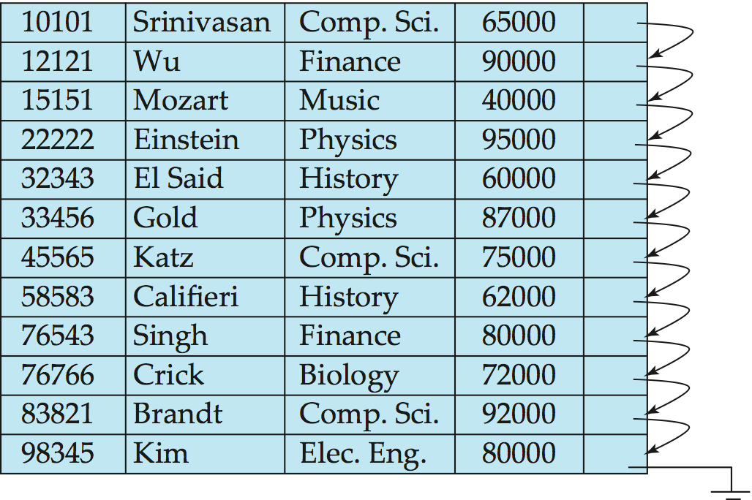
Sequential File Organization
Suitable for applications that require sequential processing of the entire file
The records in the file are ordered by a search-key

Slide 26
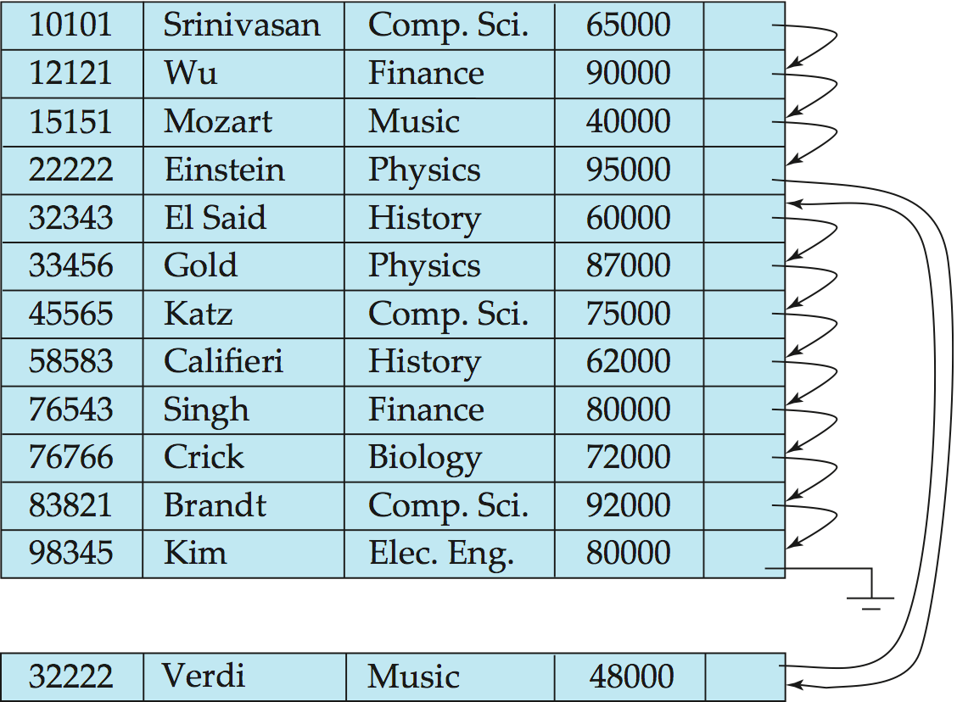
Sequential File Organization (Cont.)
Deletion – use pointer chains
Insertion –locate the position where the record is to be inserted
if there is free space insert there
if no free space, insert the record in an overflow block
In either case, pointer chain must be updated
Need to reorganize the file from time to time to restore sequential order

Slide 27
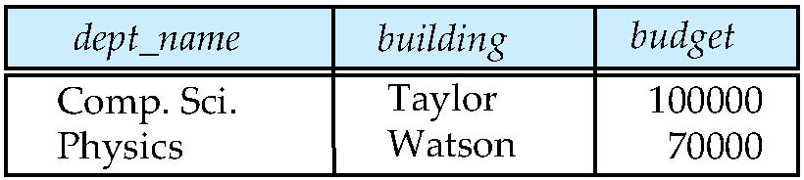
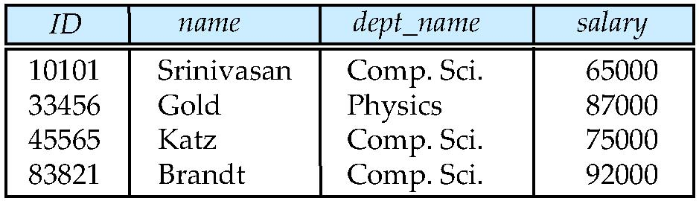
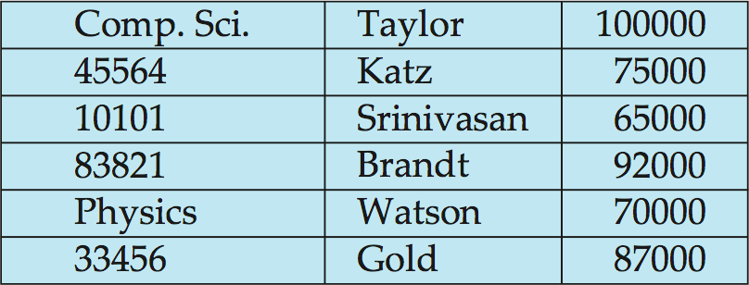
Multitable Clustering File Organization
Store several relations in one file using a multitable clustering file organization
department
instructor
multitable clustering
of department and
instructor

Slide 28
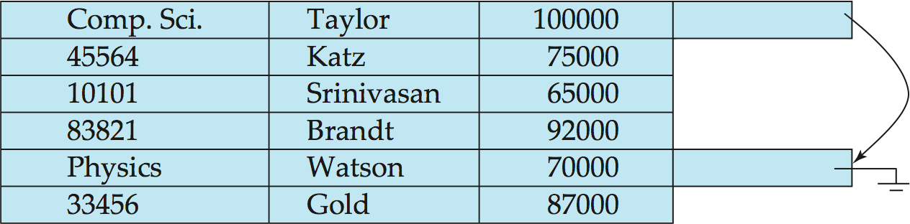
Multitable Clustering File Organization (cont.)
good for queries involving department instructor, and for queries involving one single department and its instructors
bad for queries involving only department
results in variable size records
Can add pointer chains to link records of a particular relation

Slide 29
Data Dictionary Storage
The Data dictionary (also called system catalog) stores metadata; that is, data about data, such as
Information about relations
names of relations
names, types and lengths of attributes of each relation
names and definitions of views
integrity constraints
User and accounting information, including passwords
Statistical and descriptive data
number of tuples in each relation
Physical file organization information
How relation is stored (sequential/hash/…)
Physical location of relation
Information about indices

Slide 30
File Organization and Index structures/files
Dense, Sparse, Primary, Secondary,
Clustered, Un-clustered files
I/O Cost based Analysis model
Notes:
1

Slide 31
Introduction
Issue
How to get required records efficiently
Example
SELECT * from R;
SELECT * from R where A=10;
Index is a data structure that lets us find quickly records with given ‘search key’ value without having to look at more than a fraction of all records
An index takes a value for search key and finds records with the matching value

Slide 32
Indexing
Can we do anything else to improve query performance other than selecting a good file organization?
Yes, the answer lies in indexing
Index - a data structure that allows the DBMS to locate particular records in a file more quickly
Very similar to the index at the end of a book to locate various topics covered in the book
Types of Index
Primary index – one primary index per file
Clustering index – one clustering index per file – data file is ordered on a non-key field and the index file is built on that non-key field
Secondary index – many secondary indexes per file
Sparse index – has only some of the search key values in the file
Dense index – has an index corresponding to every search key value in the file

Slide 33
An index file takes much less space than the corresponding data file
An index is especially advantageous if it can fit in memory
A record can be found with only one disk I/O
An index itself can be too large to fit in the memory
Multi-level indexes
Only part of index in memory

Slide 34
Types of index structures
Simple indexes on sorted files
Usually, created on primary key
Secondary indexes on unsorted files
Clustered indexes
B-trees, a commonly used structure
Hash table

Slide 35
Two Types of Indices
Ordered index (Primary index or clustering index) – which is used to access data sorted by order of values.
Hash index (secondary index or non-clustering index ) - used to access data that is distributed uniformly across a range of buckets.

Slide 36
Index
Mechanism for efficiently locating row(s) without having to scan entire table
Based on a search key: rows having a particular value for the search key attributes can be quickly located
Don’t confuse candidate key with search key:
Candidate key: set of attributes; guarantees uniqueness
Search key: sequence of attributes; does not guarantee uniqueness –just used for search

Slide 37
Indexes
Sometimes need to retrieve records by the values in one or more fields, e.g.,
Find all students in the “CS” department
Find all students with a cgpa > 8
An index on a file is a:
Disk-based data structure
Speeds up selections on the search key fields for the index.
Any subset of the fields of a relation can be index search key
Search key is not the same as (candidate) key
(e.g. doesn’t have to be unique).
An index
Contains a collection of index and data entries
Supports efficient retrieval of all records with a given search key value k.

Slide 38
Basic Concepts
Indexing is used to speed up access to desired data.
E.g. author catalog in library
A search key is an attribute or set of attributes used to look up records in a file. Unrelated to keys in the db schema.
An index file consists of records called index entries.
An index entry for key k may consist of
An actual data record (with search key value k)
A pair (k, rid) where rid is a pointer to the actual data record
A pair (k, bid) where bid is a pointer to a bucket of record pointers
Index files are typically much smaller than the original file if the actual data records are in a separate file.
If the index contains the data records, there is a single file with a special organization.

Slide 39
Types of Indices
The records in a file may be unordered or ordered sequentially by some search key.
A file whose records are unordered is called a heap file.
If an index contains the actual data records or the records are sorted by search key in a separate file, the index is called clustering (otherwise non-clustering).
In an ordered index, index entries are sorted on the search key value. Other index structures include trees and hash tables.

Slide 40
Primary Indexes (On sorted files)
The simplest structure
The data file is a sequential file
The data file is sorted on a key, usually primary key
The index file consists of <key,pointer> pairs
Types of indexes
Dense: every record has an entry in the index
Sparse: only some of the data records have entries in the index

Slide 41
Types of Single-Level Indexes
Primary Index
Defined on an ordered data file
The data file is ordered on a key field
Includes one index entry for each block in the data file; the index entry has the key field value for the first record in the block, which is called the block anchor
A similar scheme can use the last record in a block.
A primary index is a nondense (sparse) index, since it includes an entry for each disk block of the data file and the keys of its anchor record rather than for every search value.

Slide 42
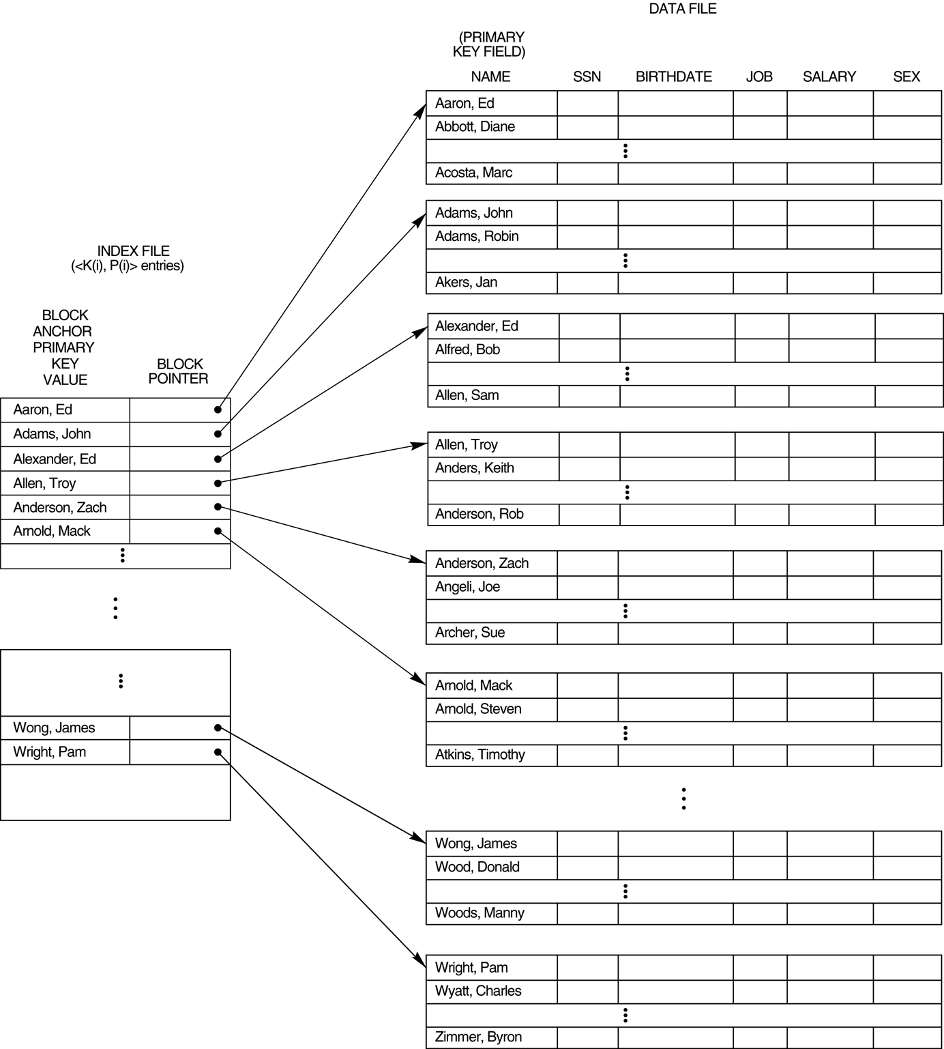
Primary index on the ordering key field of the file

Slide 43
Index Structure
Contains:
Index entries
Can contain the data tuple itself (index and table are integrated in this case); or
Search key value and a pointer to a row having that value; table stored separately in this case – unintegrated index
Location mechanism
Algorithm + data structure for locating an index entry with a given search key value
Index entries are stored in accordance with the search key value
Entries with the same search key value are stored together (hash, B- tree)
Entries may be sorted on search key value (B-tree)

Slide 44
Index Structure
S
Search key
value
Location Mechanism
Location mechanism
facilitates finding
index entry for S
S
Index entries
Once index entry is found, the row can be directly accessed
S, …….

Slide 45
Dense indexes
Every key from the data file is represented
Entries are in the same order as that of the file
Binary search can be used to find the required <key, pointer>
No.of blocks searched ‘log n’ instead of n/2 on an average

Slide 46
Example: 1,000,000 tuples, 10 tuples/4096 byte block, key field 30 bytes, pointer 8 bytes
Data file takes 400MB space
Index file will take 10,000 blocks with100 entries/block
Search will involve at most log10000 = 13 blocks in MM
Memory can also be optimized by keeping only most searched blocks in memory
Hence a record can be retrieved with less than 14 disk I/Os

Slide 47
Sparse indexes
Useful if dense index is too large
Uses less space at the cost of possibly more time to search
Generally a record, usually the first, per block is represented
Sparse index for previous example would take only 1000 blocks, 4MB
But, it can not give quick answer to query ‘does there exist a record with key value K?”
It requires one disk I/O with searching in the block
Search K: find entry with largest key ≤ K

Slide 48
Sparse Vs Dense Index
Dense index: index entry for each data record
Unclustered index must be dense
Clustered index need not be dense
Sparse index: index entry for each block of data file

Slide 49
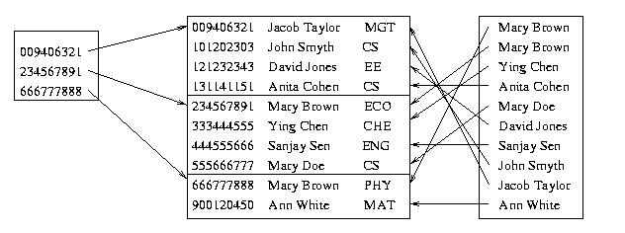
Sparse Vs. Dense Index
Id Name Dept
Sparse,
clustered
index sorted
on Id
data file sorted
on Id
Dense,
unclustered
index sorted
on Name

Slide 50
Clustered vs. Unclustered Index
Clustered (main/primary) index: index entries and rows are ordered in the same way
An integrated storage structure is always clustered
There can be at most one clustered index on a table
Unclustered (secondary) index: index entries and rows are not sorted on the same search key
There can be many secondary indices on a table

Slide 51
Clustering and Non-clustering
Non-clustering indices have to be dense.
Indices offer substantial benefits when searching for records.
When a file is modified, every index on the file must be updated. Updating indices imposes overhead on database modification.
Sequential scan using clustering index is efficient, but a sequential scan using a non-clustering index is expensive – each record access may fetch a new block from disk.
Block fetch requires about 5 to 10 micro seconds, versus about 100 nanoseconds for memory access

Slide 52
Clustered Index
Good for range searches
Use location mechanism to locate index entry at start of range
This locates first data record.
Subsequent data records are contiguous if index is clustered (not so if unclustered)
Minimizes page transfers and maximizes likelihood of cache hits

Slide 53
Sparse Index Files
A clustering index may be sparse.
Index records for only some search-key values.
To locate a record with search-key value k we:
Find index record with largest search-key value < k
Search file sequentially starting at the record to which the index record points
Less space and less maintenance overhead for insertions and deletions.
Generally slower than dense index for locating records.
Good tradeoff: sparse index with an index entry for every block in file, corresponding to least search-key value in the block.

Slide 54
Types of Single-Level Indexes
Secondary Index
A secondary index provides a secondary means of accessing a file for which some primary access already exists.
The secondary index may be on a field which is a candidate key and has a unique value in every record, or a nonkey with duplicate values.
The index is an ordered file with two fields.
The first field is of the same data type as some nonordering field of the data file that is an indexing field.
The second field is either a block pointer or a record pointer. There can be many secondary indexes (and hence, indexing fields) for the same file.
Includes one entry for each record in the data file; hence, it is a dense index

Slide 55
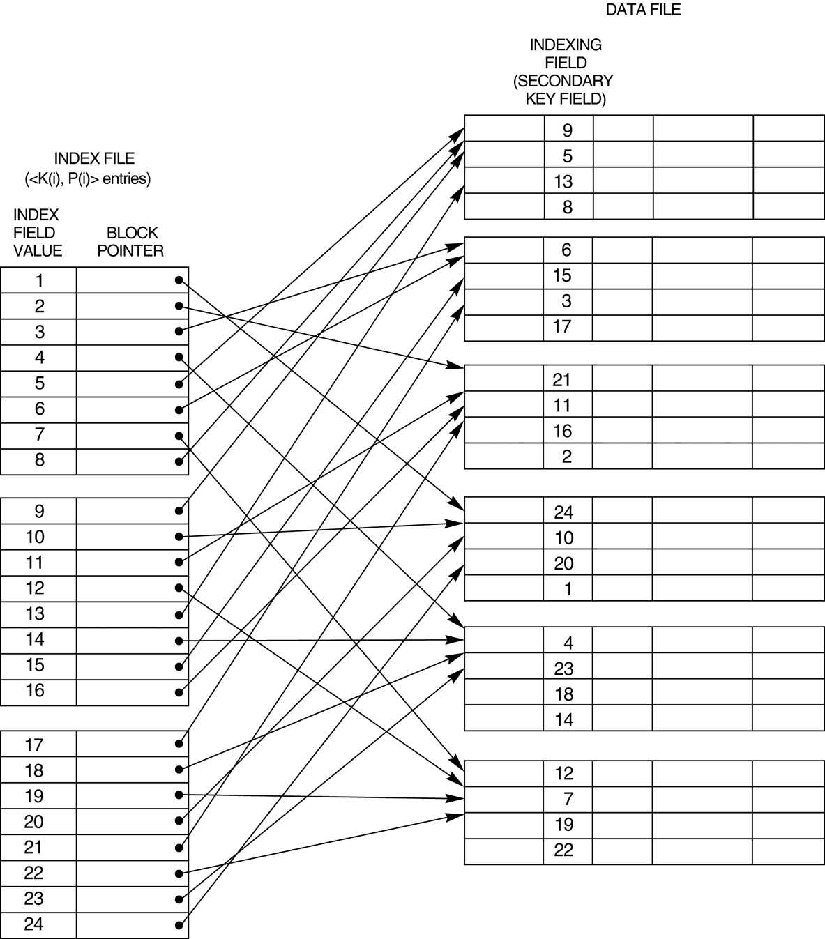
A dense secondary index (with block pointers) on a nonordering key field of a file.

Slide 56
Secondary indexes
SELECT name, address
FROM MovieStar
WHERE birthdate=DATE ‘1952-01-01’
CREATE INDEX BDIndex ON MovieStar(birthdate);
Secondary indexes are always ‘dense’
Second level index could be ‘sparse’
Secondary indexes are usually with duplicates

Slide 57
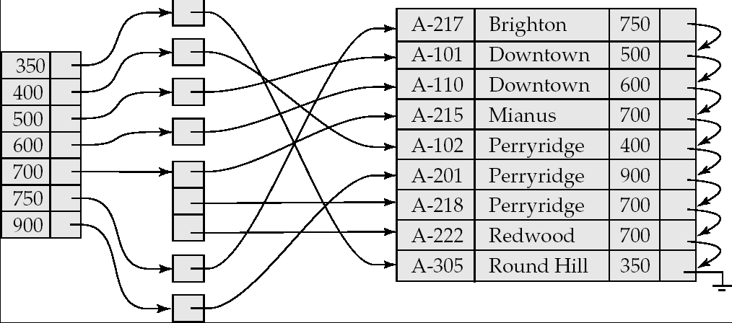
Secondary Indices Example
Secondary index on balance field of account
Index record points to a bucket that contains pointers to all the actual records with that particular search-key value.

Slide 58
20
40
Secondary index
10
10
20
20
10
20
50
30
20
30
40
50
10
50
60
20

Slide 59
Pointers in one index block may refer to multiple data blocks
Results in more number of Disk I/Os
Unavoidable problem
Using ‘bucket file’ between index file and data file
Single entry <k,p> for each value ‘k’ where p points to location in bucket file containing all other pointers of records with value ‘k’
Avoids wastage of space due to multiple storage of same value ‘k’

Slide 60
Definition of Bucket
Bucket - another form of a storage unit that can store one or more records of information.
Buckets are used if the search key value cannot form a candidate key, or if the file is not stored in search key order.

Slide 61
20
40
10
20
30
40
10
20
50
30
50
60
10
50
60
20
Index file
Bucket file
Data file

Slide 62
Application of ‘bucket file’
It can help answer queries efficiently using intersection of pointer sets
Example
SELECT title
FROM Movie
WHERE StudioName=‘Disney’ AND year=1995;
This reduces number of Disk I/Os

Slide 63
Movie Tuples
Buckets for studio
Buckets for year
Disney
1995
Studio index
Year index

Slide 64
Multi-level indexes
When an index is too large with even binary search taking too many disk I/Os
Define second level index: index on index
This can continue to multi-level index structure
Second and higher level indexes must be sparse
Second level index in previous example would take only 10 blocks, 40KB
Search involves 2 disk I/Os and searching in the block

Slide 65
Multilevel Index
If an index does not fit in memory, access becomes expensive.
To reduce number of disk accesses to index records, treat the index kept on disk as a sequential file and construct a sparse index on it.
outer index – a sparse index on main index
inner index – the main index file
If even outer index is too large to fit in main memory, yet another level of index can be created, and so on.
Indices at all levels must be updated on insertion or deletion from the file.

Slide 66
Multilevel Index (Cont.)
outer index
inner index
Data
Block 0
Index
Block 0


Data
Block 1

Index
Block 1





Slide 67
Multi-level indexes
When an index is too large with even binary search taking too many disk I/Os
Define second level index: index on index
This can continue to multi-level index structure
Second and higher level indexes must be sparse
Second level index in previous example would take only 100 blocks, 400KB
Search involves 6 disk I/Os and searching in the block

